Slide 1
Password based Security System
By- Anuj Vyas, Pranav Tella and
Janhavi Zarapkar

Slide 2
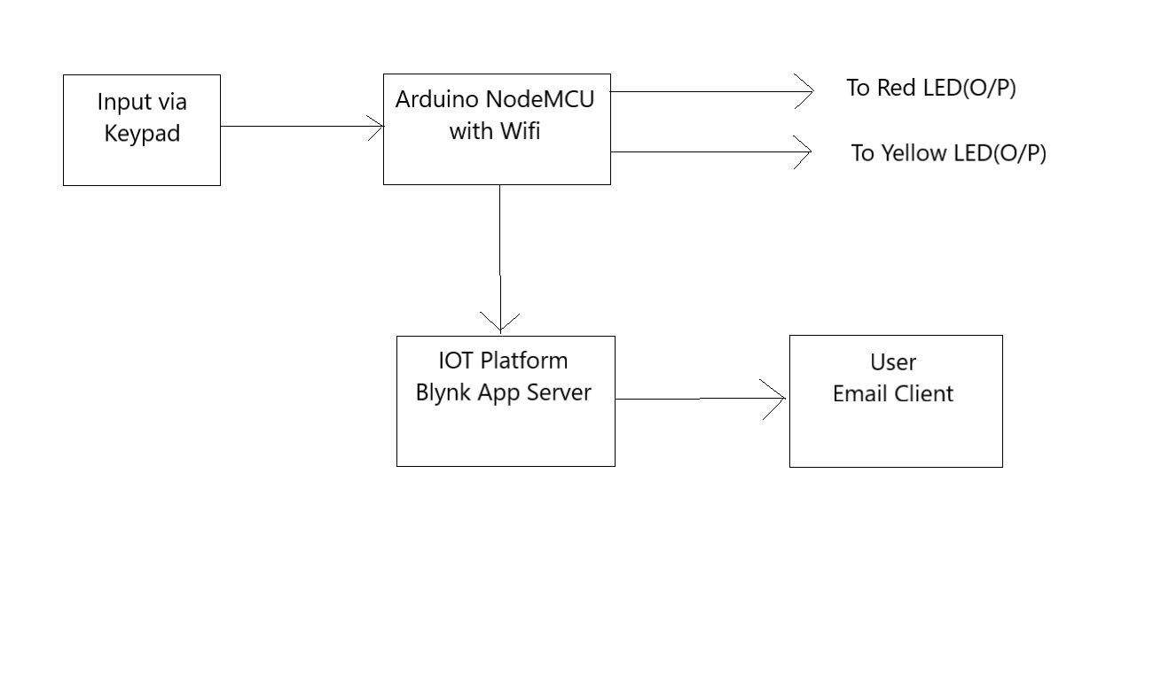
Block Diagram

Slide 3
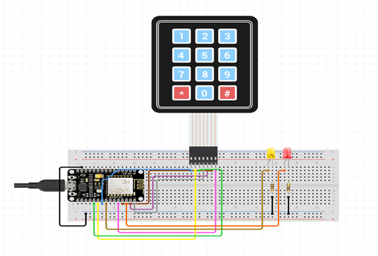
Circuit Diagram

Slide 4
#include<Blynk.h>
#include <ESP8266WiFi.h>
#include <BlynkSimpleEsp8266.h>
#include <Keypad.h>
#define Password_Lenght 5
// Give enough room for 4 chars + NULL char
char Data[Password_Lenght];
// 4 is the number of chars it can hold + the null char = 5
char Master[Password_Lenght]= "4466";
char customKey;
// Used for storing the input from the user.
int correct = 15; // Yellow led is connected to the D8 pin ie: GPIO 15
int wrong = 2; // Red led is connected to the D8 pin ie: GPIO 2
int wrong_email = 0;
int data_count = 0;
Int door = 1;
const byte ROWS = 4;
const byte COLS = 3;
char keys[ROWS][COLS] = { {'1', '2', '3'}, {'4', '5', '6'}, {'7', '8', '9'}, {'*', '0', '#'} };
byte rowPins[ROWS] = {0, 4, 5, 16}; //connect to D3,D2,D1,D0 ie: 0,4,5,16 of GPIO
byte colPins[COLS] = {13, 12, 14}; //connect to D7,D6,D5 ie: 13,12 and 14 of GPIO
// Initialize an instance of class NewKeypad
Keypad customKeypad( makeKeymap(keys), rowPins, colPins, ROWS, COLS);
char auth[] = "dHON-oA9BzDHSItcujInBT9PFQrrg4tu";
//Put your token here
char ssid[] = "J"; //Wifi name
char pass[] = "janhavi11"; //Wifi password
BlynkTimer timer;
void setup() {
// Debug console
Serial.begin(9600);
Blynk.begin(auth, ssid, pass);
// Establishing the connection with the blynk app.
pinMode(correct, OUTPUT);
pinMode(wrong, OUTPUT);
//Setup a function to be called every second
timer.setInterval(1000L, myTimerEvent); delay(3000);
}
//0 stands for door open //1 stands for door closed
void loop() {
Blynk.run();
timer.run();
if (door == 0){
customKey = customKeypad.getKey();
if (customKey == '#') {
door = 1;
Blynk.virtualWrite(V4, "System is locked.");
digitalWrite(correct, LOW); // turn the LED off
digitalWrite(wrong, HIGH); // turn the LED on
}
}
else Open();
}
void myTimerEvent() {
Blynk.virtualWrite(V5, Data);
}

Slide 5
void Open() {
customKey = customKeypad.getKey();
// makes sure a key is actually pressed, equal to (customKey != NO_KEY)
if (customKey) {
Data[data_count] = customKey;
Blynk.virtualWrite(V5, Data); // store char into data array
data_count = data_count + 1;
}
// if the array index = no. of expected chars
if (data_count == Password_Lenght - 1) {
if (!strcmp(Data, Master))
// equal to (strcmp(Data, Master) == 0)
{
door = 0;
wrong_email = 0;
digitalWrite(correct, HIGH); // turn the yellow LED on
digitalWrite(wrong, LOW); // turn the red LED off
Blynk.virtualWrite(V4, "Access Granted");
}
else {
door = 1;
wrong_email = wrong_email + 1;
Blynk.virtualWrite(V4, "Access Denied.");
Blynk.notify("Alert: Wrong Password.");
digitalWrite(wrong, HIGH); // turn the red LED on
digitalWrite(correct, LOW); // turn the yellow LED off }
delay(1000);
clearData();
}
if (wrong_email == 3) {
Blynk.email("janhavi.zarapkar@gmail.com","Access Denied","Alert!, Someone tried to access your system with invalid password more than 2 consecutive times.");
wrong_email = 0;
}
}
void clearData() {
while (data_count != -1) {
Data[data_count] = 0; //clear array for new data
data_count = data_count - 1;
}
data_count = data_count + 1;
}

Slide 6
Conclusion
Since, security has become a major concern for everyone it is important to have a security system that helps us have a look at any time if anyone is trying to enter the premises or access the system by using unethical means.
Using this device, personalized security can be provided for the people in their day-to-day lives and they themselves can monitor the systems as per their needs. As the user will get notified every time an intruder tries to access the system, this inappropriate intrusion can be prevented and measures can be taken to take the required action on this activity.
Hence, this device will provide better security in terms of managing and having an overview of our own system if anyone tries to access it in a wrong way.

